Slide 1
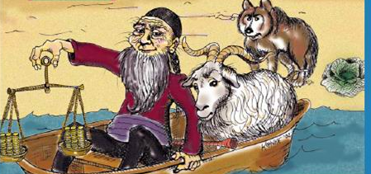

Analysis and Design of Algorithms
Transform Coding
Chapter 1: Introduction
School of Software Engineering © Ye Luo

Slide 2
Introduction of Teachers
Contact Information
  Office: Jishi Building, Room 314
  Email: yeluo@tongji.edu.cn
Course Information:
Slides can be downloaded from:
QQ 群 共享文件
TA Information:

Slide 3
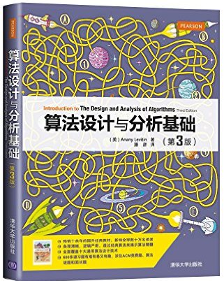
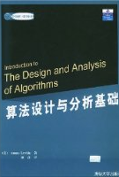
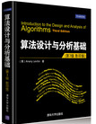
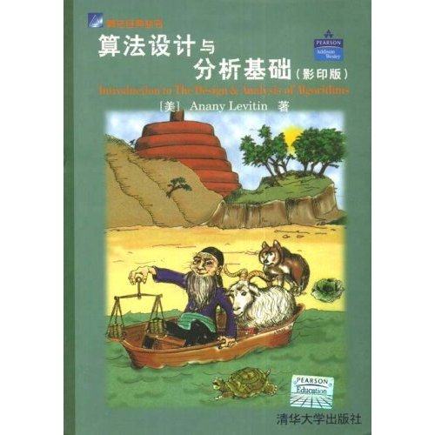
Our References
算法设计与分析基础(第3版) .
（美）Anany Levitin 著，潘彦译 .
清华大学出版社 .2015年2月.
Introduction to the Design and Analysis of Algorithms.
Anany Levitin.
清华大学出版社. 2003年.

Slide 4
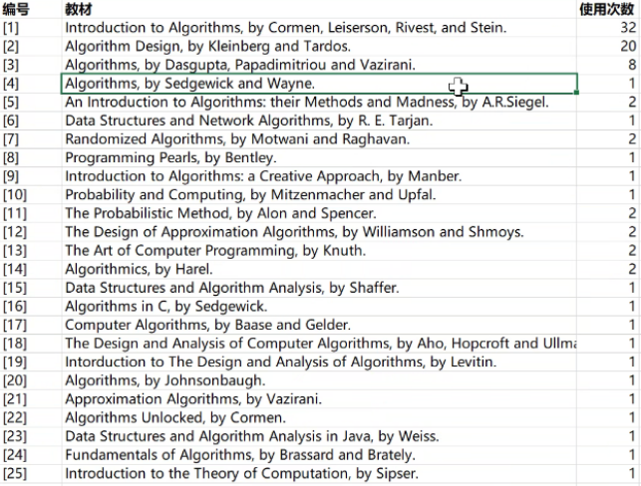
Survey of Reference Books Worldwide

Slide 5
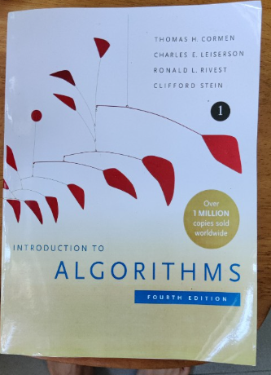
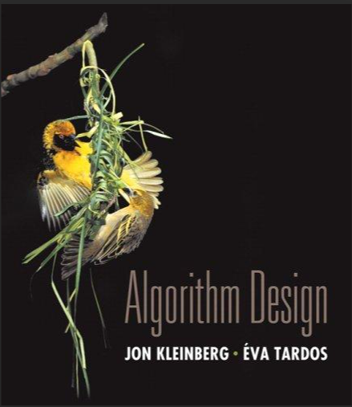
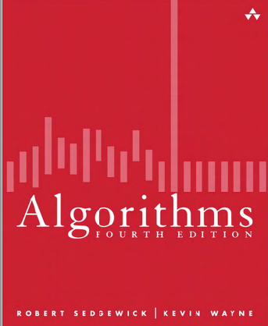
Classical References
Introduction To Algorithms (MIT Press 4th Edition). Thomas H.Cormen.
高等教育出版社& The MIT Press. 2022年. 《算法导论》
Algorithm Design (Pearson Press 1st Edtion). Jon Kleinberg, Eva Tardos, Cornell University
Algorithms (Pearson Press, 4th Edition). Robert Sedgewick, Kevin Wayne, 2011, Princeton University
https://sedgewick.io/
Notes:
https://sedgewick.io/

Slide 6
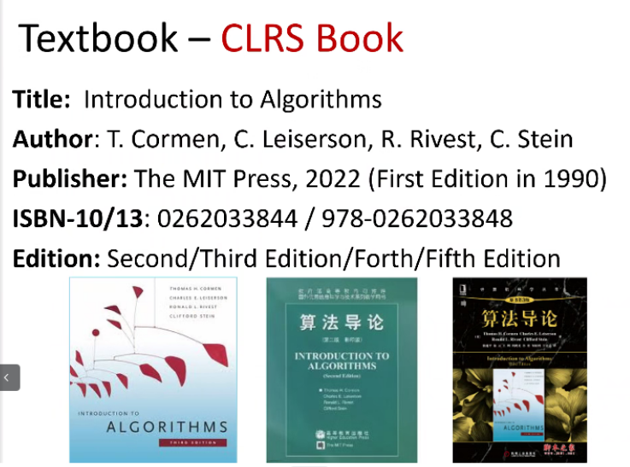
Classical Reference 1

Slide 7
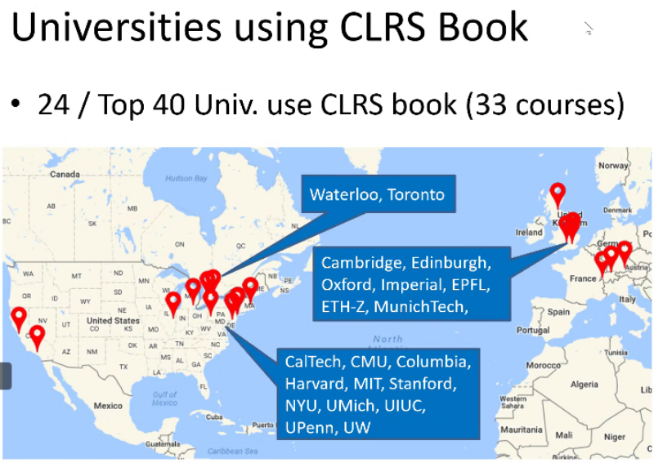
Classical Reference 1

Slide 8
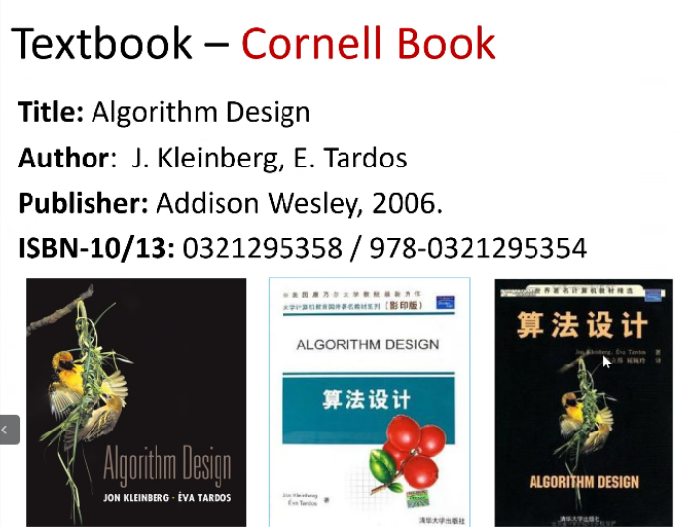
Classical Reference 2

Slide 9
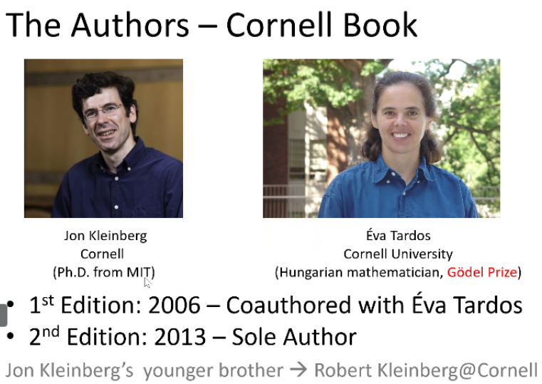
Classical Reference 2

Slide 10
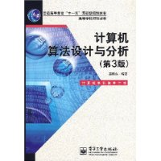
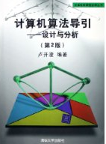
Chinese Version References
算法设计与分析(第三版). 王晓东.
电子工业出版社.2007年5月.
计算机算法导引: 设计与分析.
卢开澄. 清华大学出版社. 2006年.
Notes:
Text Book:
Anany Levitin, Introduction to the Design and Analysis of Algorithms, Tsinghua University Press, 2003, 39RMB.
Reference Books:
M.H. Alsuwaiyel, Algorithms Design Techniques and Analysis, Publishing House of Electronics Industry, 2003, 40RMB.
Thomas H. Cormen etc., Introduction to Algorithms (Second Edition), Higher Education Press & The MIT Press, 68RMB.
Others, search on the website with keyword “Design and Analysis of algorithm”, you will find more...

Slide 11
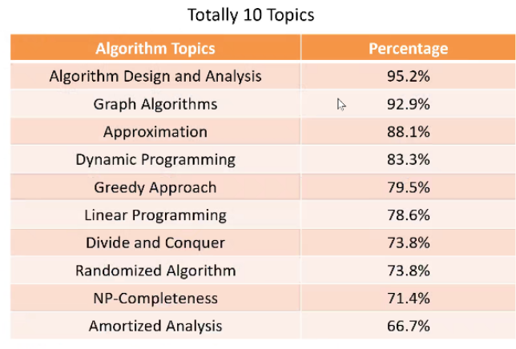
Survey of Topics Introduced Worldwide

Slide 12
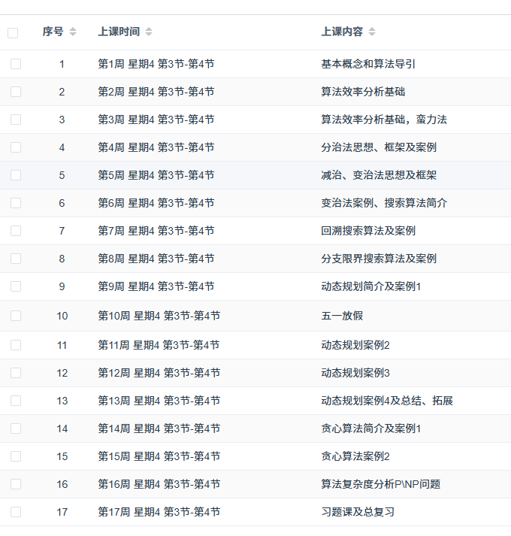
Topics Introduced in Our Class

Slide 13
Examination
• Homework: 40%, 4 times(10%+10%+10%+10%)
• Final examination: 50%
• Attendance: 5% (being absent >=5 times, you will fail this course)
• Class activity: 5% being active in class and answering questions correctly

Slide 14
Course Prerequisite
Data Structure
C, Java or other programming languages
Discrete Mathematics
Advanced Mathematics
Notes:
� 先修课程：
数据结构、离散数学、高级程序设计语言*结构化设计、高等数学

Slide 15

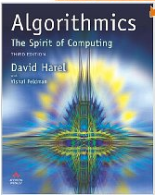
Why we learn Algorithm ?
Donald E. Knuth Stanford Univ. Turning Award 1974
    The Art of Computer Programming
    Computer Science is the study of algorithms.
    Cornerstone of computer science.
    Programs will not exist without algorithms.
Algorithmics: the Spirit of Computing
Prof. David Harel Dean of Faculty of Mathematics and
Computer Science, the Weizmann Institute of Science
  Algorithmics is more than a branch of computer science. It is the core of computer science, and, in all fairness, can be said to be relevant to most of science, business, and technology.
Only when you teach your computer technologies, you can get REAL control of it
Notes:
2. 正如算法和程序设计技术的先驱，图灵奖获得者Danold E. Knuth所说，计算机程序设计的艺术
“计算机科学就是算法的研究”。
计算机系统中的任何软件，都是按一个个特定的算法来予以实现的。
算法性能的好坏，直接决定了所实现软件性能的优劣。
如何判定一个算法的性能、用什么方法来设计算法、所设计的算法需要多少运行时间、多少存储空间，在实现一个软件时，这些都是必须予以解决的，算法设计与分析技术正是用来解决上述问题的。
2. 算法不仅是计算机科学的一个分支，它更是计算机科学的核心，而且，可以毫不夸张地说，它和绝大多数的科学、商业和技术都是相关的。——David Harel《算法：计算的灵魂》
------
计算机解题的过程中，无论是形成解题思路还是编写程序，都是在实施某种算法。前者是推理实现的算法，后者是操作实现的算法。
一个人只有把知识教给“计算机”，才能“真正”掌握它。 Only when you teach your computer technologies, you can get REAL control of it

Slide 16
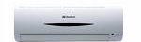
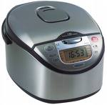
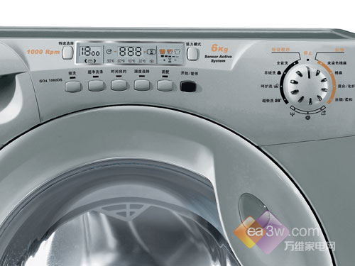

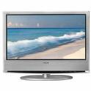


Why we learn Algorithm ?
Closely related to our lives
Help to guide how to analyze and solve problems
Help to develop the ability of analyzing and solving problems via computers

Slide 17

Applications of algorithms
Human Genome Project
  identifying all the 100,000 genes in human DNA
  determining the sequences of that make up human DNA, the 3 billion chemical base pairs
  storing this information in databases
  developing tools for data analysis
  ideas and techniques in this course are used in the solution of these biological problems
  accomplish tasks while using resources efficiently
  Savings in time, human, machine, and money
Notes:
� 找出人类DNA中所有100000种基因，确定构成人类DNA的30亿种化学基对的各种序列。
� 快速地访问和检索互联网数据
� 电子商务活动中各种信息的加密及签名
� 制造业中各种资源的有效分配
� 确定地图中两地之间的最短路径
� 各种数学、几何计算（矩阵、方程、集合）

Slide 18

Applications of algorithms
The Internet
  quickly access and retrieve large amounts of information
  algorithms are employed to manage and manipulate this large volume of data
  e.g. finding good routes on which the data will travel
  e.g. information search engine

Slide 19
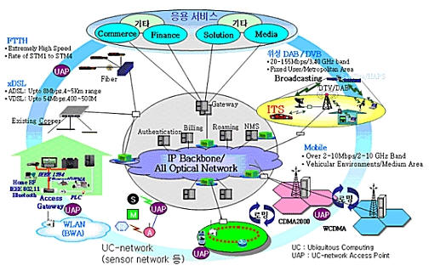

Applications of algorithms
Communications
  How to transmit multimedia data
  How to organize different information streams on the network
  How to storage data on the network
  multimedia information retrieval
Notes:
打电话：传送语音
下载：传送数据
看电视：传送视频数据
打手机，无线－固网－移动，

Slide 20

Applications of algorithms
Cryptography in e- commerce
  to keep information such as credit card numbers, passwords, and bank statements private
  Public-key cryptography and digital signatures
Notes:
电子商务活动中各种信息的加密及签名

Slide 21
Applications of algorithms
In manufacturing and other commercial settings,
  An oil company may wish to know where to place its wells in order to maximize its expected profit.
  An airline may wish to assign crews to flights in the least expensive way possible, making sure that each flight is covered
  An Internet service provider may wish to determine where to place additional resources in order to serve its customers more effectively.
  — linear programming
Notes:
制造业中各种资源的有效分配

Slide 22
What we learn in this course ?
Systematical study of classical algorithms in the computer science area
Master the typical techniques and methods of algorithms design
Abilities of analyzing complexity of algorithms
Be able to design algorithms for simple or complex practical problems
Try to make the algorithms efficient and effective to enhance the quality of programming.
Notes:
（一）教学目的
通过本课程的教学，使学生系统的学习和研究计算机领域常见而有代表性的算法；
理解并掌握算法设计的主要方法；
培养对算法复杂性进行分析的能力。
旨在培养学生分析问题和解决问题的能力。同时为学生以后进一步的学习奠定良好的基础。
（二）教学要求
通过本课程的学习，要求学生掌握算法设计的基本技巧和方法，如蛮力法、分治法、减治法、变治法、动态规划技术、贪心策略等；
熟悉算法分析的基本技术，包括算法时间和空间复杂性的分析方法；
并能熟练运用一些常用算法，以便运用这些算法来设计解决一些常用的或较为复杂的实际问题的算法，并力争做到快捷、有效，从而提高程序设计的质量。
－－－－－－－－－
� 课程主要介绍计算机算法分析、算法设计及复杂性理论的基本概念、基本的算法分析方法和常用的算法设计方法。
� 目标：
掌握计算机算法分析的基本方法及常见算法设计方法
训练逻辑思维
利用常见的算法设计方法解决软件开发中的实际问题

Slide 23
Chapter 1: Introduction
What’s Algorithm
Example of Algorithm
Algorithm vs. Program
Algorithmic problem solving
Contents of Algorithm

Slide 24
What’s Algorithm
Notation
The algorithm describes a specific computational procedure for solving a well-specified computational problem.
The statement of the problem specifies in general terms the desired input/output relationship. An algorithm is for achieving that input/output relationship.
Can achieve the desired output
  for any specific legitimate input
  in a finite amount of time.
An algorithm is a finite sequence of unambiguous instructions
problem
algorithm
input
computer
output
Notes:
1. 人们使用计算机，就是要利用计算机处理各种不同的问题，而要做到这一点，人们就必须事先对各类问题进行分析，确定解决问题的具体方法和步骤，再编制好一组让计算机执行的指令即程序，交给计算机，让计算机按人们指定的步骤有效地工作。这些具体的方法和步骤，其实就是解决一个问题的算法.
算法是指解决问题的一种方法或一个过程
2.
We can also view an algorithm as a tool for solving a well-specified computational problem. The statement of the problem specifies in general terms the desired input/output relationship. The algorithm describes a specific computational procedure for achieving that input/output relationship.
An algorithm is any well-defined computational procedure that takes some value, or set of values, as input and produces some value, or set of values, as output.
算法是在有限步骤内求解某一问题所使用的一组定义明确的规则 。
算法是若干指令的有穷序列，
3.
能够对一定规范的输入，在有限时间内获得所要求的输出
An algorithm is a sequence of unambiguous instructions for solving a computational problem, i.e., for obtaining a required output for any legitimate input in a finite amount of time.
－－－－－
《计算机算法基础》
算法是一组有穷的规则，它规定了解决某一特定类型问题的一系列运算。

Slide 25
What’s Algorithm
Properties of algorithms
  Input: 0 or more valid input values, to provide the initialization conditions
  Output:
      produce the correct output given a valid input
      at least one value is produced by the algorithm
      desired input/output relationship specified by the problem
  Tangibility(确定性):
      each instruction / each step is clearly
      precisely and unambiguously specified
      Example: 不符合确定性的运算
      5/0
      将6或7与x相加
      未赋值变量参与运算
Notes:
一个算法应该具有以下五个重要的特征：
3、输入：一个算法有0个或多个输入，以刻画运算对象的初始情况，所谓0个输入是指算法本身定出了初始条件；
4、输出：一个算法有一个或多个输出，以反映对输入数据加工后的结果。没有输出的算法是毫无意义的；
2、tangibility 确切性： 算法的每一步骤必须有确切的定义；组成算法的每条指令是清晰，无歧义的
例：不符合确定性的运算
5/0
将6或7与x相加
未赋值变量参与运算
1、有穷性： 一个算法必须保证执行有限步之后结束；
5、可行性： 算法原则上能够精确地运行，而且人们用笔和纸做有限次运算后即可完成。

Slide 26
What’s Algorithm
Properties of algorithms
  Finiteness:
      finite instructions,
      finite execution times for each instruction
      finite running time for each instruction
  Feasibility: could be precisely executed and effectively computable;
      Steps must be sufficiently simple and basic.
Notes:
1、有穷性： 一个算法必须保证执行有限步之后结束；
5、可行性： 算法原则上能够精确地运行，而且人们用笔和纸做有限次运算后即可完成。

Slide 27
What’s Algorithm
Some points for algorithms
  Each step of an algorithm must be unambiguous.
  Different algorithms for a certain problem
  Different representations to describe a certain algorithm
  Different ideas and different execution speed for different algorithms
Notes:
�同样的一个算法可以用几种不同的形式来描述。
�可能存在几种解决相同问题的算法。
�针对同一个问题的算法可能会基于完全不同的解题思路，而且解题的速度也会有明显区别。
Each step of an algorithm must be unambiguous.
1 The same algorithm can be represented in several different ways. (different pseudocodes)
2 There might exists more than one algorithm for a certain problem.
3 Algorithms for the same problem can be based on very different ideas and can solve the problem with dramatically different speeds.

Slide 28
Example of Algorithm
Problem: Computing the Greatest Common Divisor of two integers
  gcd(m, n): the largest integer that divides both m and n
Algorithm I
  Euclid’s algorithm:
  gcd(m, n) = gcd(n, m mod n) iteratively while n≠0
  gcd(m, 0) = m
  Natural language
    Step1: If n = 0, return the value of m as the answer and stop;
    otherwise, proceed to Step 2.
    Step2: Divide m by n and assign the value of the remainder to r.
    Step 3: Assign the value of n to m and the value of r to n. Go to Step 1.
Notes:
GCD(22,8) = GCD(8,6) = GCD(6,2) = GCD(2,0) = 2; 最大公约数

Slide 29
Example of Algorithm
  Pseudocode
    A mixture of a natural language and programming language-like structures
    Precise and succinct
    Pseudocode in this course
    omits declarations of variables
    use indentation to show the scope of such statements as for, if, and while.
    Use ←for assignment
Algorithm Euclid(m, n)
//Computes gcd(m, n) by Euclid’s algorithm
//Input: Two nonnegative, not-both-zero integers m and n
//Output: Greatest common divisor of m and n
while n ≠ 0 do
r ← m mod n
m ← n
n ← r
return m
Notes:
Succinct 简洁的

Slide 30
Example of Algorithm
Algorithm II
  Consecutive Integer Algorithm
    Step1: Assign the value of min{m, n} to t.
    Step2: Divide m by t. If the remainder of this division is 0, go to Step3;
    otherwise, go to Step 4.
    Step3: Divide n by t. If the remainder of this division is 0, return the value of t as the answer and stop;
    otherwise, proceed to Step4.
    Step4: Decrease the value of t by 1. Go to Step2.
Notes:
gcd(m,n)的连续整数检测算法
第一步：将min{m,n}的值赋给t。
第二步：m除以t，如果余数为0，则进入第三步；否则，进入第四步。
第三步：n除以t，如果余数为0 ，则返回t值作为结果；否则，进入第四步。
第四步：把t的值减1。返回第二步。

Slide 31
Example of Algorithm
Algorithm II
  Consecutive Integer Algorithm
Algorithm ConsecutiveInteger(m, n)
//使用连续整数检测法计算gcd(m，n)
//输入：两个不全为0的非负整数m,n
//输出：m,n的最大公约数
if n=0 return n
t=min{m,n}
while t>0 do
if (m mod t)==0
if (n mod t)==0
return t
else t=t-1
else t=t-1
return t
Notes:
gcd(m,n)的连续整数检测算法
第一步：将min{m,n}的值赋给t。
第二步：m除以t，如果余数为0，则进入第三步；否则，进入第四步。
第三步：n除以t，如果余数为0 ，则返回t值作为结果；否则，进入第四步。
第四步：把t的值减1。返回第二步。

Slide 32
Example of Algorithm
Algorithm III ？
  Middle-school procedure
    Step1: Find the prime factors of m.
    Step2: Find the prime factors of n.
    Step3: Identify all the common factors in the two prime expansions found in Step1 and Step2. (If p is a common factor occurring Pm and Pn times in m and n, respectively, it should be repeated in min{Pm, Pn} times.)
    Step4: Compute the product of all the common factors and return it as the gcd of the numbers given.
  ?
  ?
Notes:
gcd(m,n)的中学计算算法
第一步：找到m的所有质因数。
第二步：找到n的所有质因数
第三步：从第一步和第二步中求得的质因数分解式找出所有的公因数
第四步：将第三步中找的质因数相乘，其结果作为给定数字的最大公因数。
exmple
60=2*2*3*5
24=2*2*2*3
gcd(60,24)=2*2*3=12

Slide 33
Algorithm vs. Program
Similarity
  Finite sequence of instructions
Difference
  Presentation:
    Algorithm —— Nature language, pseudo code, flow charts
    Program —— Coded using some specific programming language
    Could be executed by some specific machine
  Execution:
    Algorithm —— finite steps
    Program —— could be infinitely executed
    e.g. Operating system
      not an algorithm, but a program running in infinite circles
      each task could be viewed as subprogram according to specific algorithm
Notes:
算法和程序都是指令的有限序列 ，但是：程序是算法，而算法不一定是 程序。
算法和程序的区别主要在于：
(1) 在语言描述上，程序必须是用规定的程序设计语言来写，而算法很随意；
(2) 在执行时间上，算法所描述的步骤一定是有限的，而程序可以无限地执行下去。
例如操作系统，是一个在无限循环中执行的程序，因而不是一个算法。
操作系统的各种任务可看成是单独的问题，每一个问题由操作系统中的一个子程序通过特定的算法来实现。该子程序得到输出结果后便终止。
程序中的指令必须是机器可执行的，而算法中的指令则无此限制。 (3)
算法,就是解决问题的一种方法,一种策略.
程序是算法用某种程序设计语言的具体实现。
算法代表了对问题的解，而程序则是算法在计算机上的特定的实现。一个算法若用程序设计语言来描述，则它就是一个程序.
algorithm is a step by step outline or flowchart how to solve a problem.
program is an implemented coding of a solution to a problem based on the algorithm.
所以： 程序 = 数据结构 + 算法

Slide 34
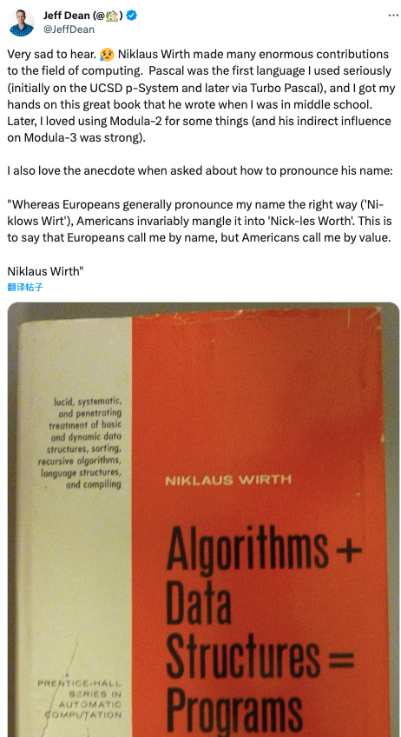
Algorithm vs. Program
Difference
  Definition:
    Algorithm — a step by step outline or flowchart how to solve a problem
    Program — an implemented coding of a solution to a problem
    based on the algorithm
    Algorithm + data structure = program

Slide 35
Algorithmic problem solving
Algorithm Design and Analysis Process
Understand the problem description
Try some examples manually
Take into consideration special examples
Define the input
- Abstract the problem and get its mathematical description
Understand the problem
Deciding on: computing methods
Exact vs. approximate problem solving
  Appropriate data structure
Scheme for the algorithm design
- Equipment performance
Computing methods: sequential or parallel
Exact solution is unavailable or speed is unacceptably low
Algorithm + data structure = program
- Nature language
pseudo code
flow charts
design an algorithm
- For every legal input, the algorithm will produce a desired output in finite time
Mathematical Induction
to prove its correctness or incorrectness ?
Proving correctness of the algorithm
Analyzing the algorithm
  Time efficiency : how fast the algorithm runs
  Space efficiency: how much extra memory the algorithm needs.
Simpleness and commonness
program coding according to the algorithm
A GOOD algorithm is the result of iterative modification
Notes:
《算法分析与设计 杨春明 西南科技大学 ppt》
1.
�理解问题
设计算法前做的第一件事情
仔细阅读问题的描述
提出疑问
手工处理一些实例
考虑特殊情况
确定输入
抽象出问题，用数学表达式描述
2.
�了解计算设备的性能
确定计算方法： RAM结构下的顺序算法；并行算法
�选择精确解和近似解
某些重要的问题无法求得精确解
某些问题利用精确解速度慢，无法接受
�确定适当的数据结构
算法 + 数据结构 = 程序
�算法设计技术
使用算法解题的一般性方法，用于解决计算领域的多种问题。
3.
详细表述算法的方法
自然语言
伪代码
流程图
4证明算法的正确性
证明对于每一个合法的输入，该算法都会在有限的时间内输出一个满足要求的结果。
一般方法：数学归纳法
证明算法的正确性与不正确哪一个更容易？
5 分析算法
算法有两种效率：时间效率和空间效率
算法的另外两个特性：简单性和一般性
6.
� 为算法写代码
用计算机程序实现算法
在把算法转变为程序的过程中，可能会发生错误或者效率非常低
作为一种规律，一个好的算法是反复努力和重新修正的结果

Slide 36
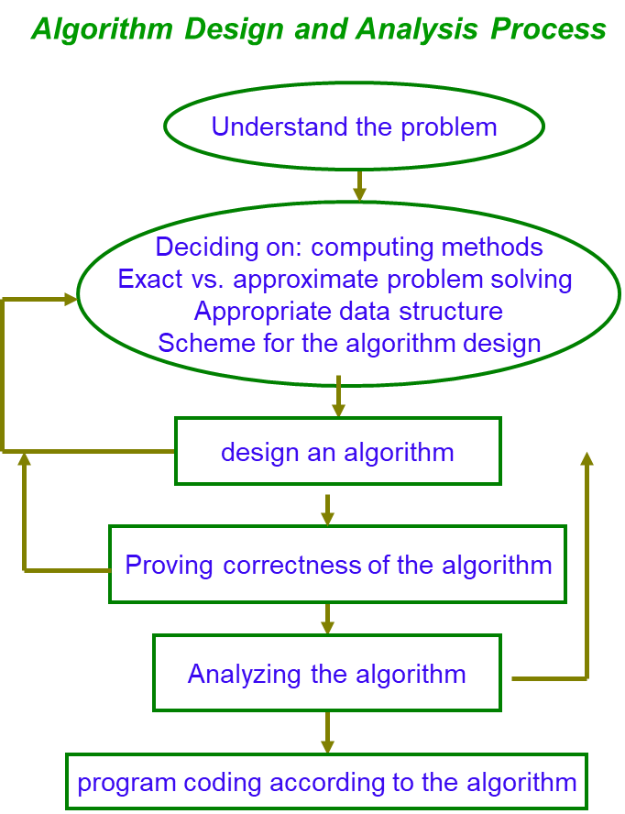

Algorithmic problem solving
Notes:
将算法的优化和迭代过程与人生的不断学习与进步相关联，从这个角度引导学生进行终身学习。

Slide 37
Contents of Algorithm
Algorithm Design Techniques/Strategies
  Brute force 蛮力法
  Divide and conquer 分治法
  Decrease and conquer 减治法
  Transform and conquer 变治法
  Greedy approach 贪心算法
  Dynamic programming 动态规划
  Back tracking 回溯法
  Branch and bound 分支界限法
Notes:
算法设计及分析技巧
�蛮力法
�分治法(Divide and Conquer)
�减治法
�变治法
�时空权衡
�动态规划(Dynamic Programming)
�贪婪技术(Greedy Algorithm)
�回溯法(Back Tracking)

Slide 38
Contents of Algorithm
How to analyze algorithm efficiency
  How good is the algorithm?
    time efficiency
    space efficiency
  Does there exist a better algorithm?
    lower bounds
    optimality

Slide 39
Contents of Algorithm
Important problem types
  sorting 排序
  searching 查找
  string processing 串处理
  graph problems 图问题
  combinatorial problems 组合问题
  geometric problems 几何问题
  numerical problems 数值问题
Notes:
�排序(Sorting)
�查找(Search)
�串处理(String)
�图问题(Graph)
�组合问题(Combination)
�几何问题(Geometry)
�数值问题

Slide 40
Contents of Algorithm
Fundamental data structures
  linear data structure
    array 数组
    linked list 单（双）链表
    string 串
    stack 栈
    queue 队列
  graph 图
  tree 树
  set and dictionary 集合与字典
Notes:
�线性数据结构
数组，串，单（双）链表，栈，队列
�图
又向图，无向图，加权图
�树
自由树，有根树
�有序树
�集合与字典
－－－－－－－－－－
<计算机算法基础> 有对数据结构的介绍
<中南民族大学 双语课程>Lecture02 Important Problem Types and Fundamental Data Structures ￥对问题类型和本课程要用的数据结构的总结很好

Slide 41
Summary
  算法的定义：在有限时间内，对问题求解的一个清晰的指令序列。算法的每个输入确定了该算法求解问题的一个实例。
  算法的特点：输入，输出，确定性，有穷性，和可行性。
  算法可以用自然语言或者伪代码表示，或计算机程序实现
  一个好的算法常常是不懈努力和反复修改的结果。
  算法操作的是数据，所以数据结构很重要。

Slide 42
思考题
Prove the equality gcd(m, n) = gcd(n, m mod n) for every pair of positive integers m and n.
http://blog.csdn.net/deserthero2013/article/details/51161696
What does Euclid’s algorithm do for a pair of numbers in which the first number is smaller than the second one? What is the largest number of times this can happen during the algorithm’s execution on such an input?

Slide 43
上机练习
1-1. Computing gcd(m, n)
1) Compose a program using Euclid’s algorithm
2) Compose a program using Consecutive Integer Algorithm
3) Find gcd(31415, 14142) by applying Euclid’s algorithm
4) Estimate how many time faster it will be to find gcd(31415, 14142) by Euclid’s algorithm compared with the algorithm based on checking consecutive integers from min{m,n} down to gcd(m,n)
1-2. find the binary representation of a positive decimal integer
Compose a program

Slide 44
上机练习
1-3. Element uniqueness problem
1) a) Compose a program using UniqueElement algorithm on P63
b) Check its efficiency in worst case, best case, and average case, in your program
2) a) Compose a program using the method in which the array is sorted firstly
b) Check its efficiency in worst case, best case, and average case, in your program

Slide 45
代码要求
1-1. GCD (1)
int gcd_Euclid (int m, int n)
{ // computes the greatest common divisor of two integers m and n using Euclid algorithm;
// Input: two integers;
// Output: their GCD
}
假定m, n 都是自然数，使用欧几里德算法求m, n的最大公约数，作为返回值;
注意：特殊情况 m < n

Slide 46
代码要求
1-1. GCD (2)
int gcd_ConsecutInteger (int m, int n)
{ // computes the greatest common divisor of two integers m and n using Consecutive Integer Algorithm ;
// Input: two integers;
// Output: their GCD
}
假定m, n 都是自然数，使用连续整数递减法求m, n的最大公约数，作为返回值；
注意：特殊情况 m < n

Slide 47
代码要求
1-2. binary representation of a positive decimal integer
int convert_decimal_to_binary(int dec_number)
{ // find the binary representation of a positive decimal integer;
//Input: a positive decimal integer;
//Output: binary integer;
}
结果输出到屏幕上（cout，printf），结果输出到一行
注意：要求不可以有前置的0，例如，结果不能是 00001111000
而是 1111000

Slide 48
代码要求
1-3. Element uniqueness problem (1)
bool UniqueElement (int A[0,…, n-1], int size)
{ // Determines whether all the elements in a given array A are distinct using the definition based algorithm;
// Input: an array A[0,…, n-1]) ;
// Output: returns true if all the elements are distinct, and false otherwise;
}

Slide 49
代码要求
1-3. Element uniqueness problem (2)
bool UniqueElement_sort (int A[0,…, n-1], int size)
{ // Determines whether all the elements in a given array A are distinct using sorting firstly;
// Input: an array A[0,…, n-1]) ;
// Output: returns true if all the elements are distinct, and false otherwise;
}

Slide 50
代码要求
提交代码注意：
所有算法写入到一个c/cpp文件中，
文件命名 10xxxx_姓名_algo_assignment1.c
Notes:
在最后交的代码中不要有main函数，我这样可以将自己的main函数和这个c文件联合编译并验证结果。

Slide 51
文档要求
对三个练习分别给出
算法本身的思路，可以用伪代码或者自然语言描述
程序中用于计算算法复杂度的方法，用文字或者公式描述清楚

